Slide 1

Notes:
- needfinding report

Slide 2
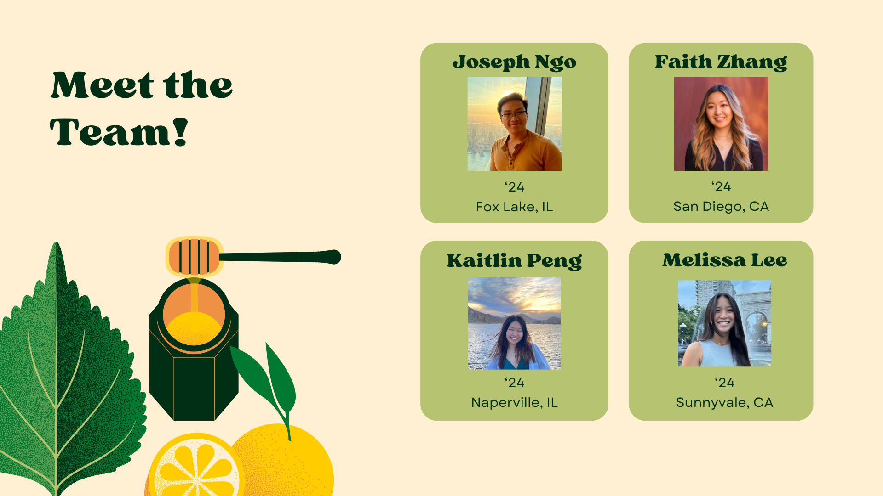
Notes:
- seniors/coterming in CS on HCI track

Slide 3
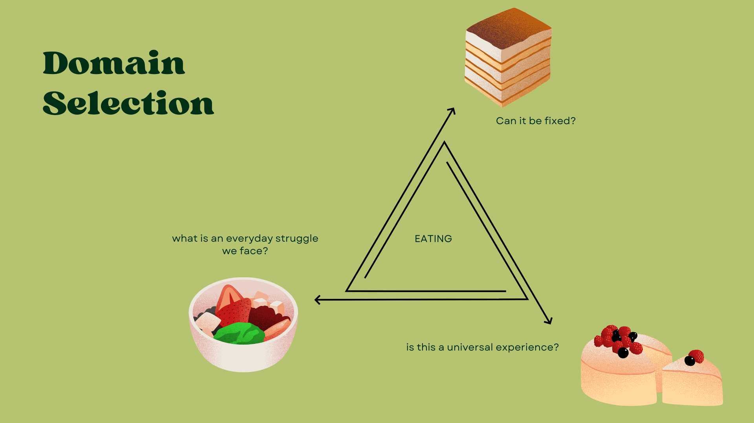
Notes:
- about project - domain selection
- first came up with these 3 main questions: what is an everyday struggle we face? is this a universal experience? can it be fixed?
- talking about lots of different ideas, got to restaurant experiences & how we and a lot of people we know have trouble deciding where to eat and what to eat at restaurants
and was interested so decided on the domain eating, specifically focusing on restaurant & food industry

Slide 4
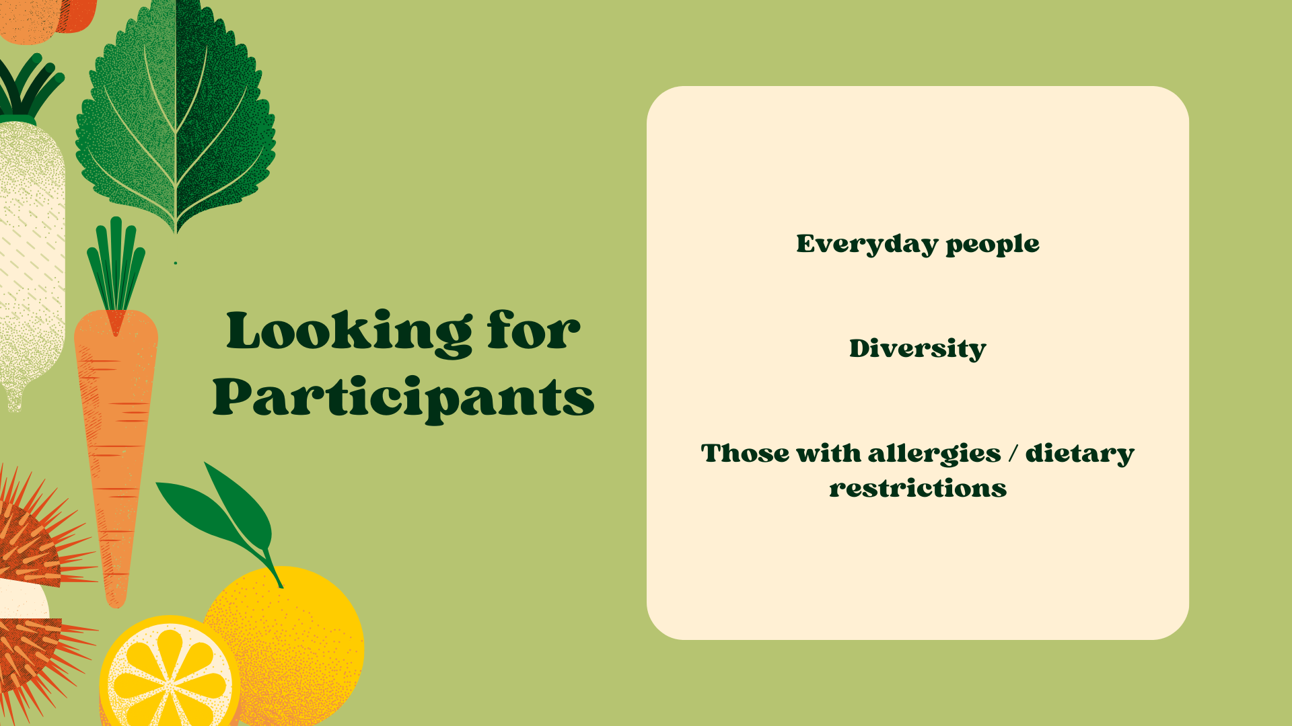
Notes:
- for interviewees, since we’re interested in seeing if this is a problem a lot of people face,
- everyday people
- diversity in age, gender, occupation, etc.
- perspective of people with allergies/dietary restrictions b/c have be more careful when selecting where and what to eat

Slide 5
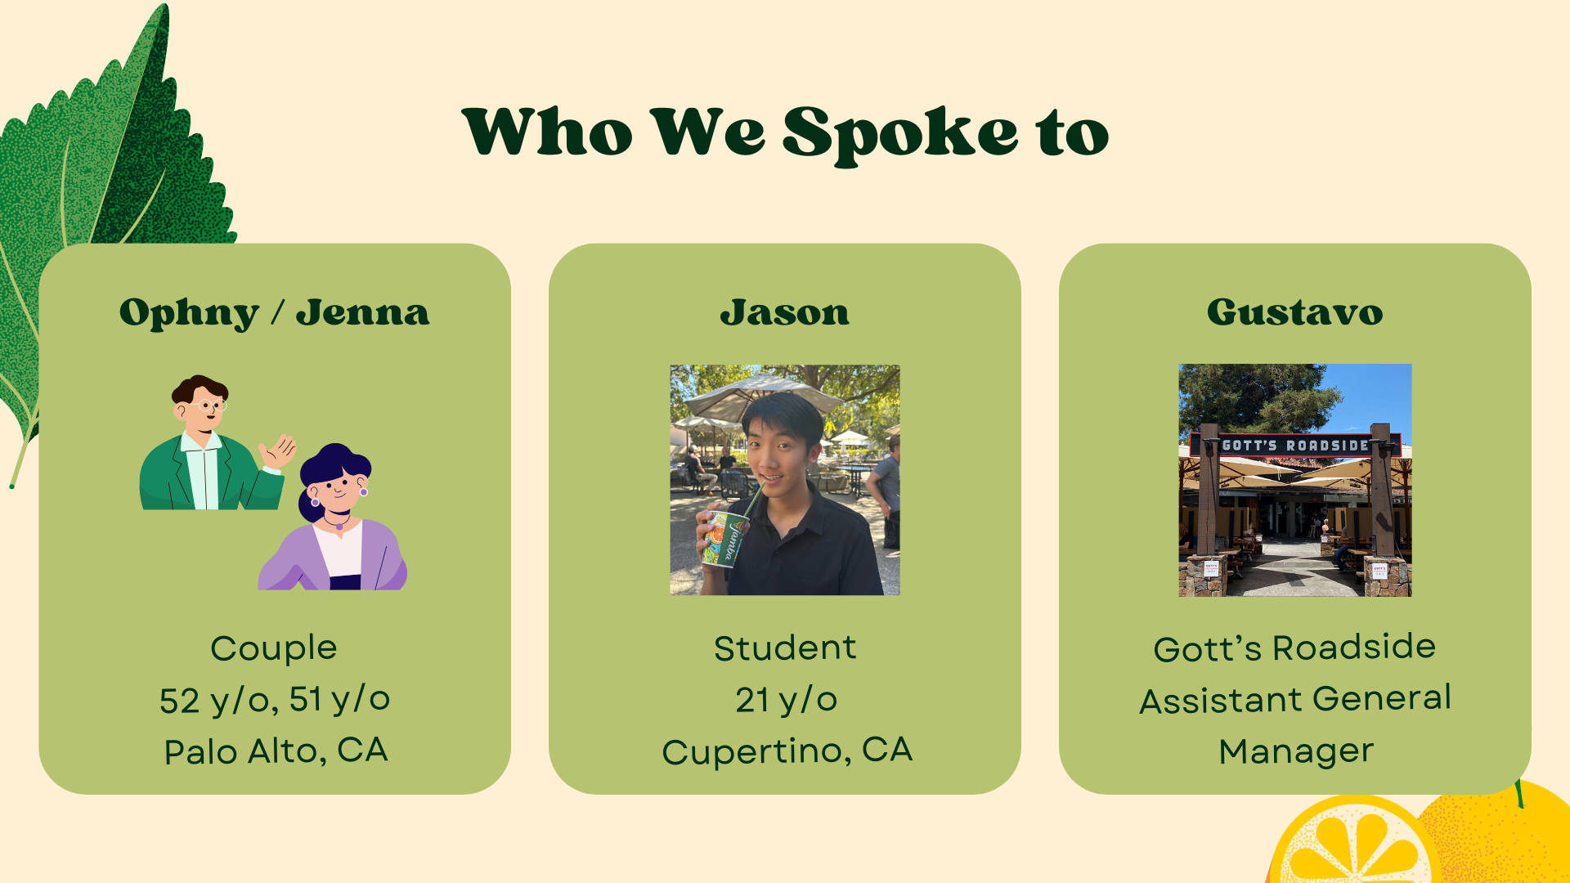
Notes:
- these are participants we found
- first interview was with 2 people, couple living in Palo Alto and are about 50 y/o, chose because everyday people and diverse age, gender
- Second was a stanford student named jason from cupertino, chose because also everyday person but has a lot of allergies which makes him our extreme user
- last wanted to choose a domain expert gustavo who’s the assistant general manager at gott’s roadside at t&c

Slide 6
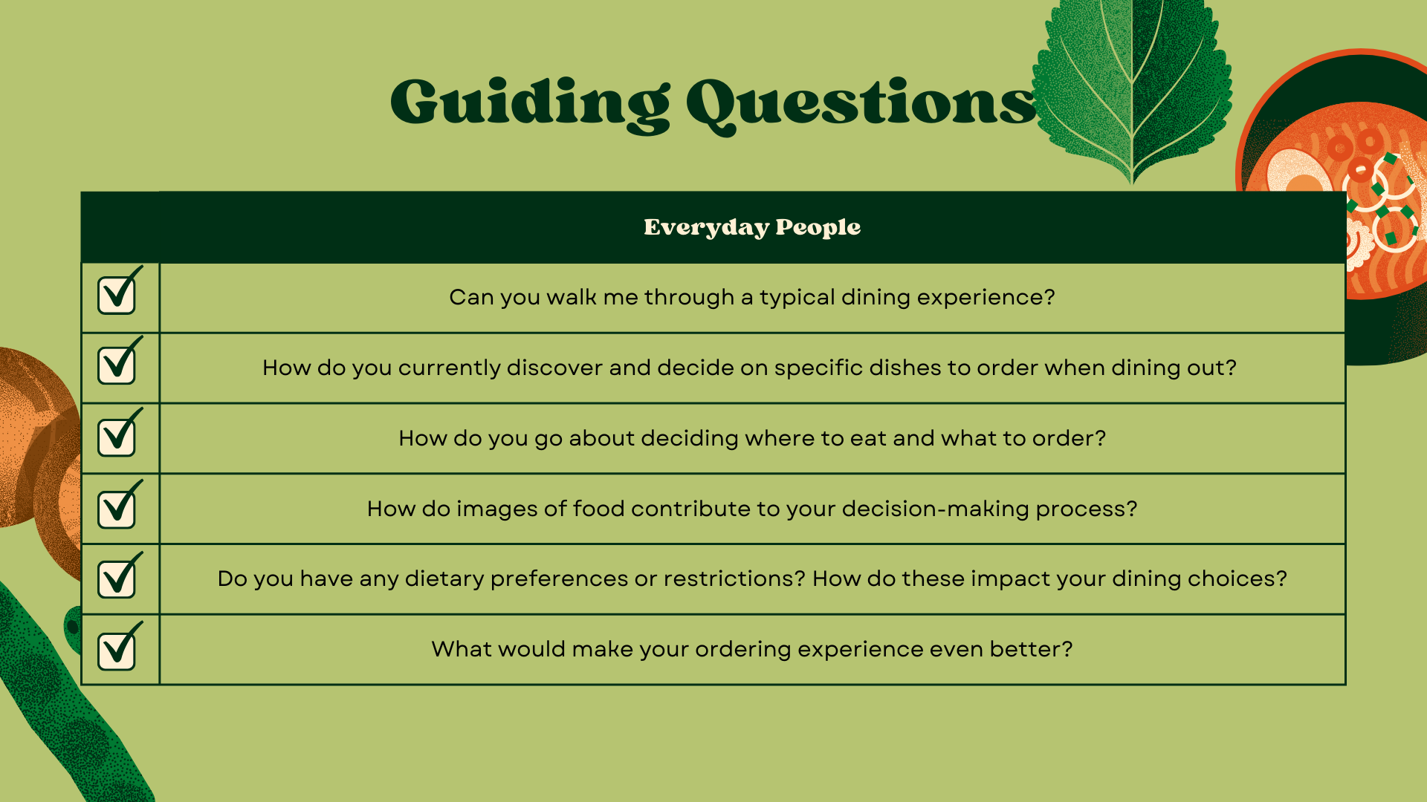
Notes:
- guiding questions for everyday people and domain expert were kind of different so first go through everything about interviews with everyday people
- for guiding questions want to know typical dining experience at restaurants, how decide where to eat and what dishes to order

Slide 7
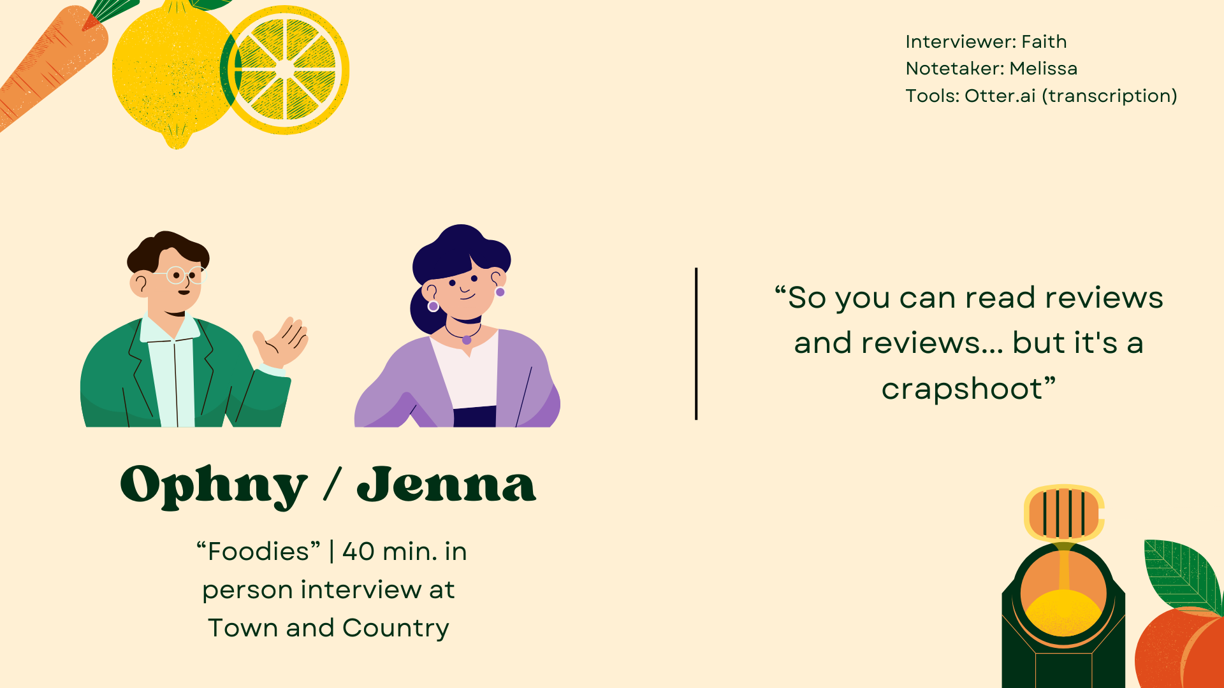
Notes:
- first interview ophny and jenna
- recruited by going around t&c and asking people who were eating if they wanted to interview
- found this couple eating poke house outside at a table and had 40 min interview with them
- compensation for all was telling them we'll follow up on project progress

Slide 8
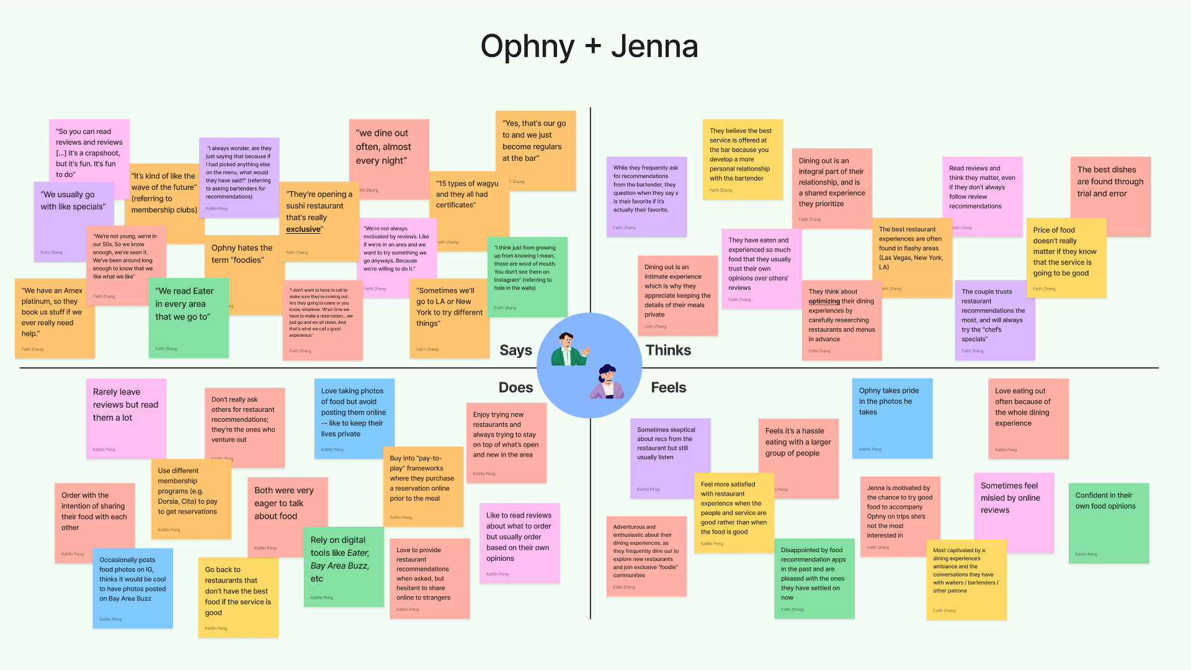

Slide 9
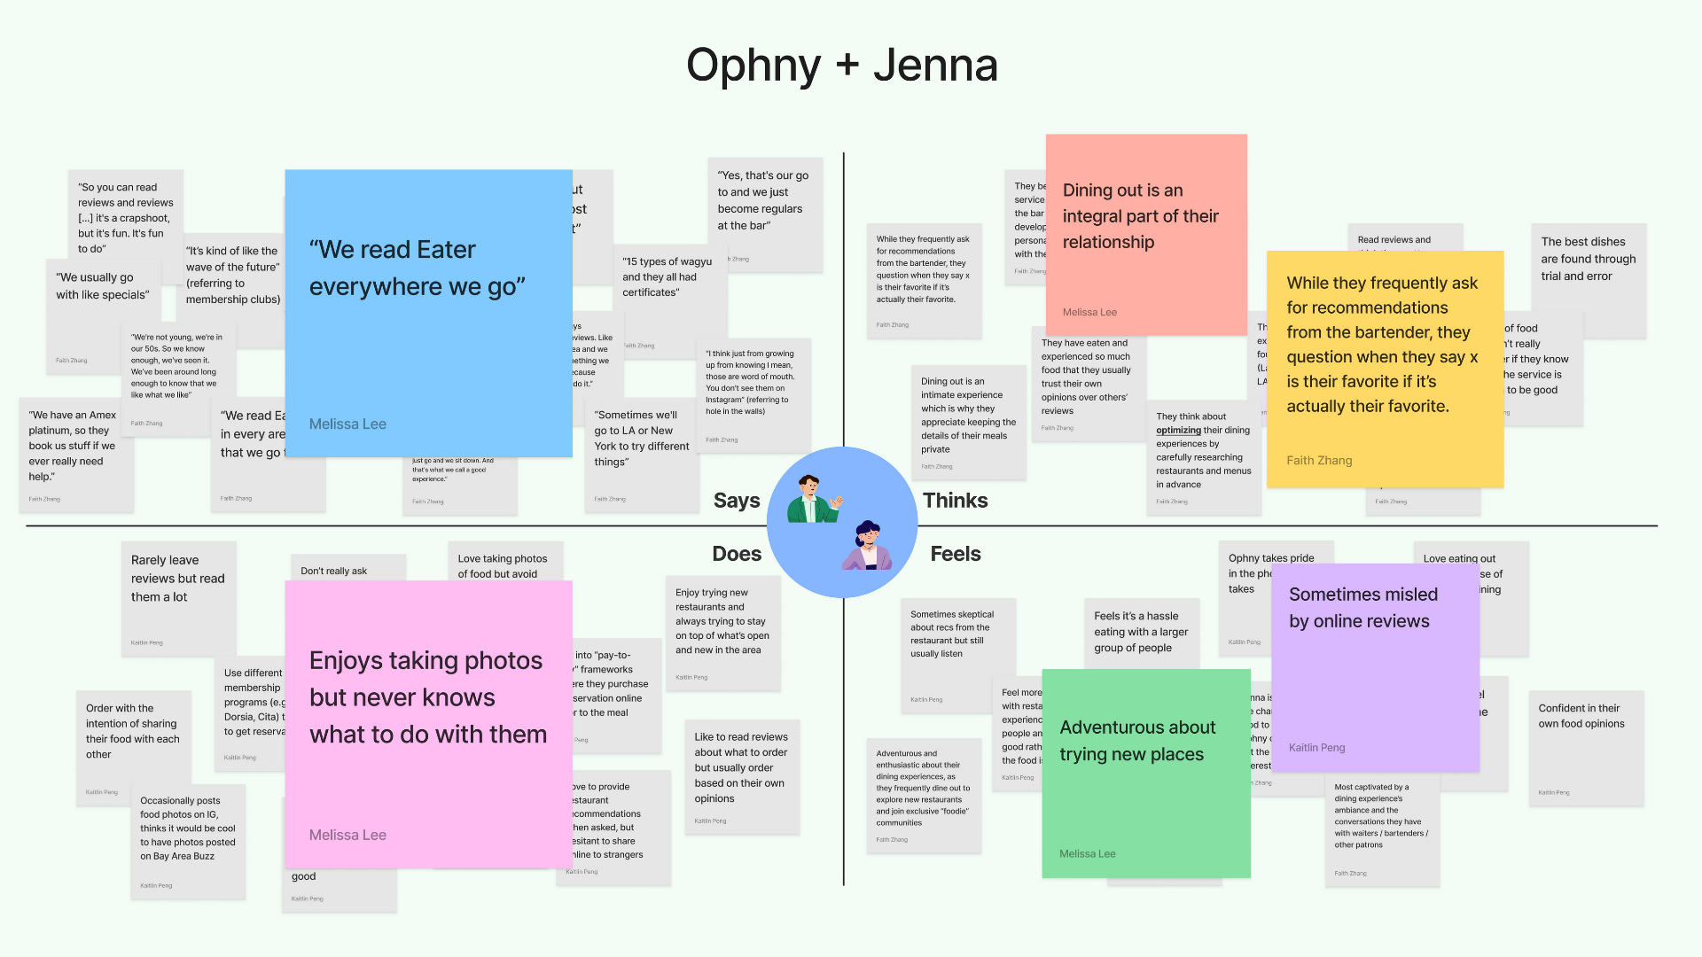
Notes:
- really big into food and the whole dining experience
- read eater everywhere they go; eater food news and dining guides website; mentioned being disappointed by other online review sites before
- trust restaurant recommendations a lot but still always skeptical about the recommendations
- feel adventurous about trying new restaurants

Slide 10
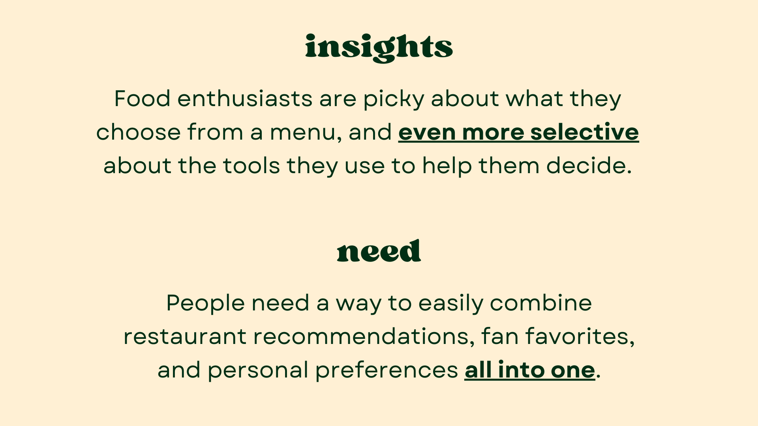
Notes:
- one of the insights from our findings was
- Food enthusiasts are picky about both what they choose from a menu how they go about choosing them
- need identified was
- People need a way to easily combine restaurant recommendations, fan favorites, and personal preferences all into one.

Slide 11
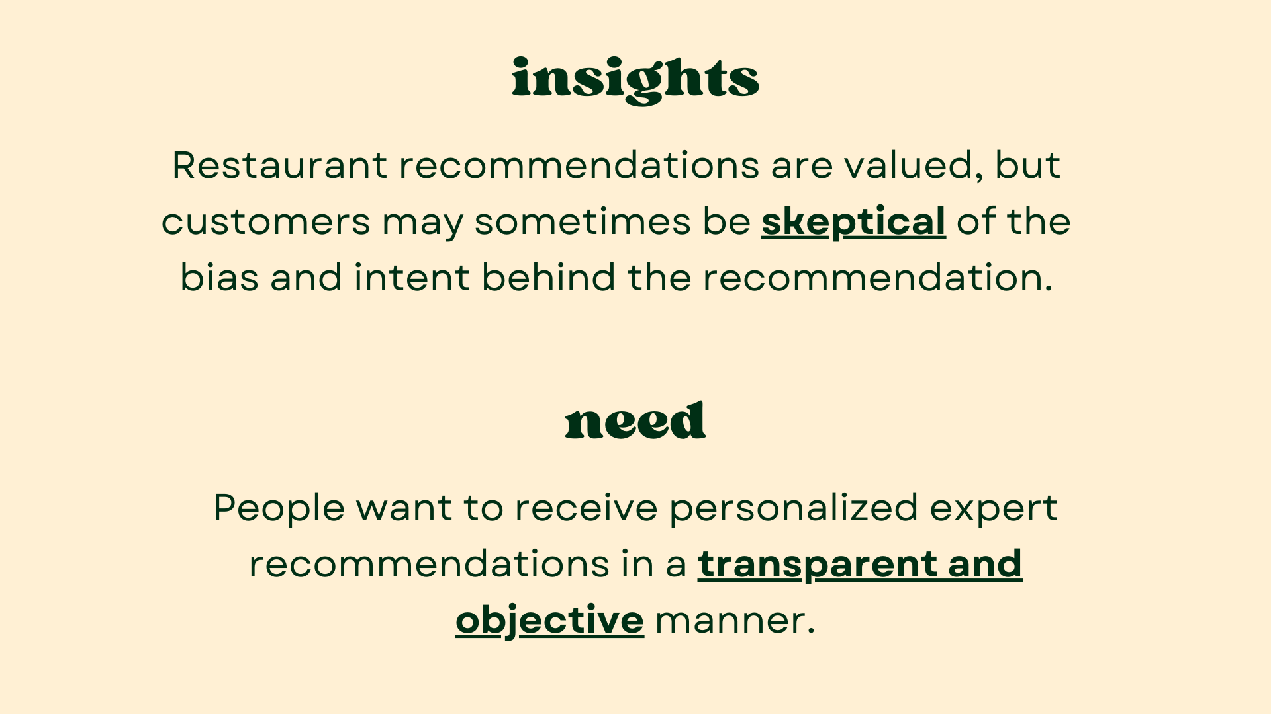
Notes:
- another insight was
- Restaurant recommendations are valued, but customers may be skeptical of them because of bias behind it
- need identified was
- People want to receive personalized expert recommendations in a transparent and objective way

Slide 12
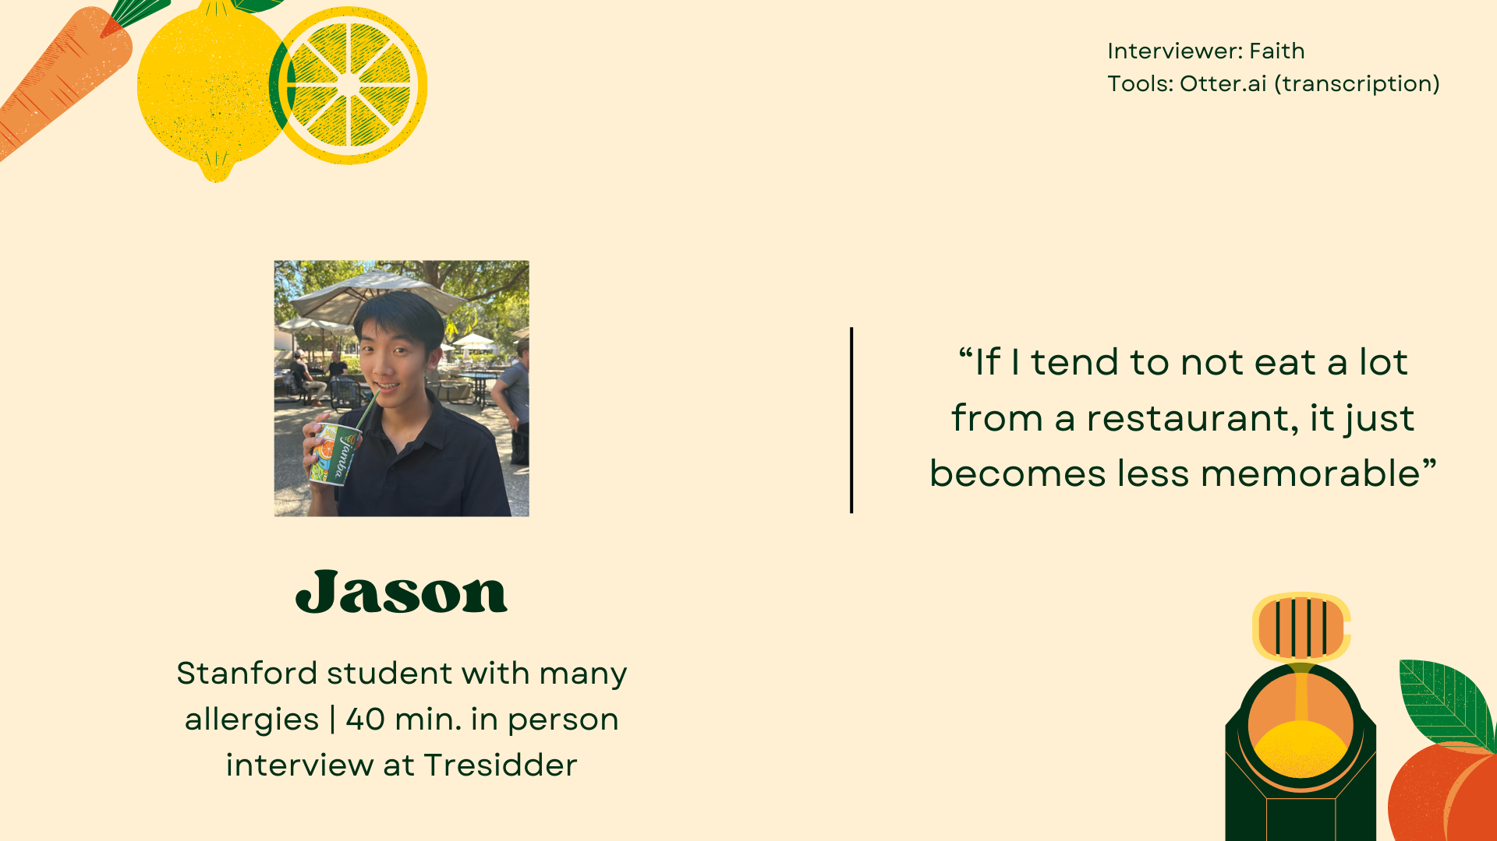
Notes:
- next is jason
- recruited because I know him and vaguely knew he had a lot of allergies, so set up interview between him and faith so no bias
- extreme user as he has to pay a lot more attention to what restaurants he goes to and what he eats
- interview at Tresidder

Slide 13
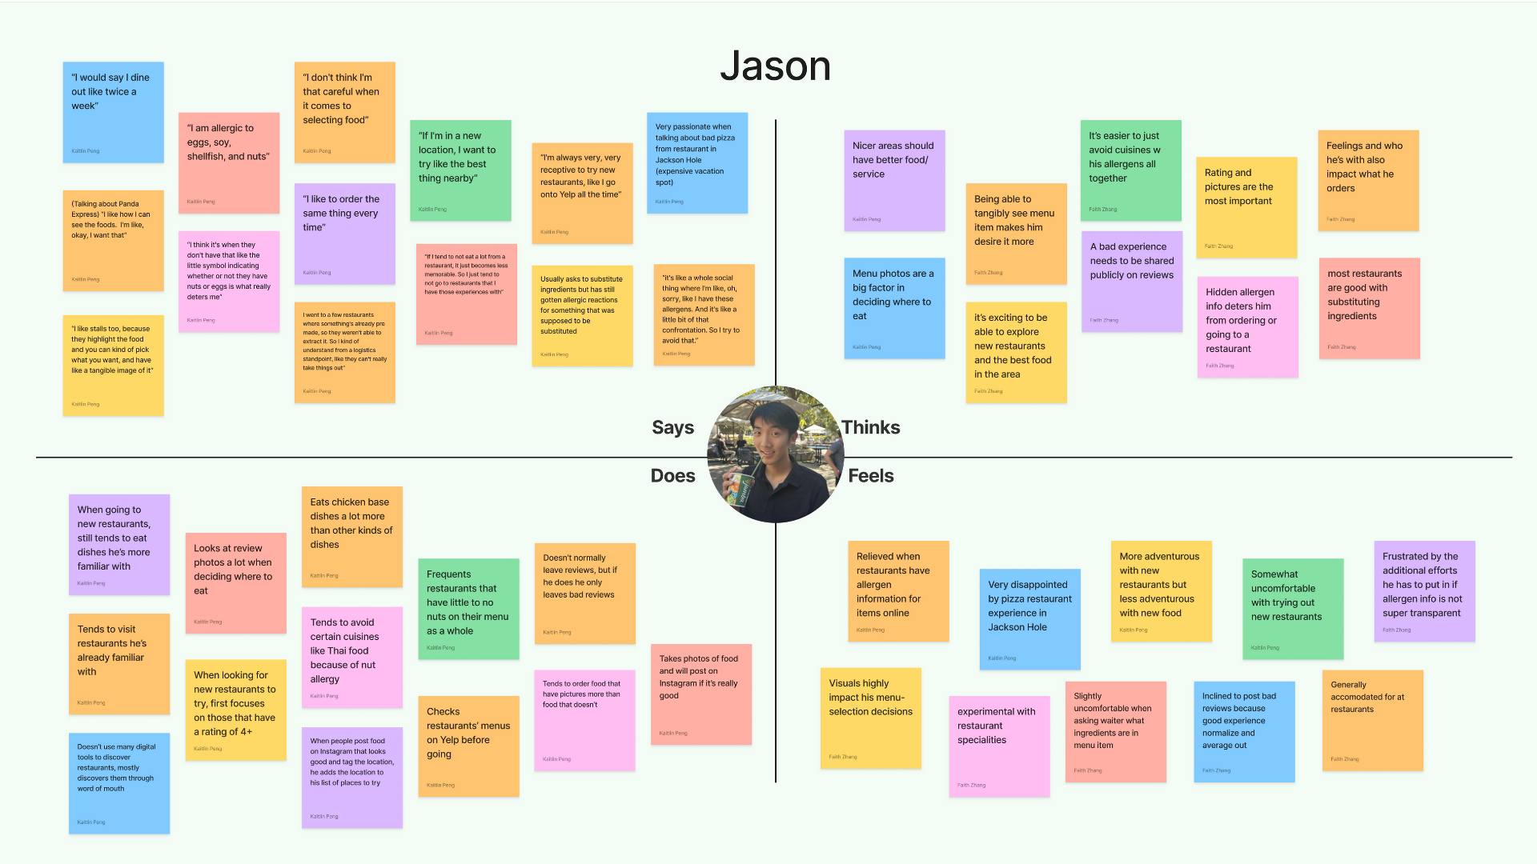

Slide 14
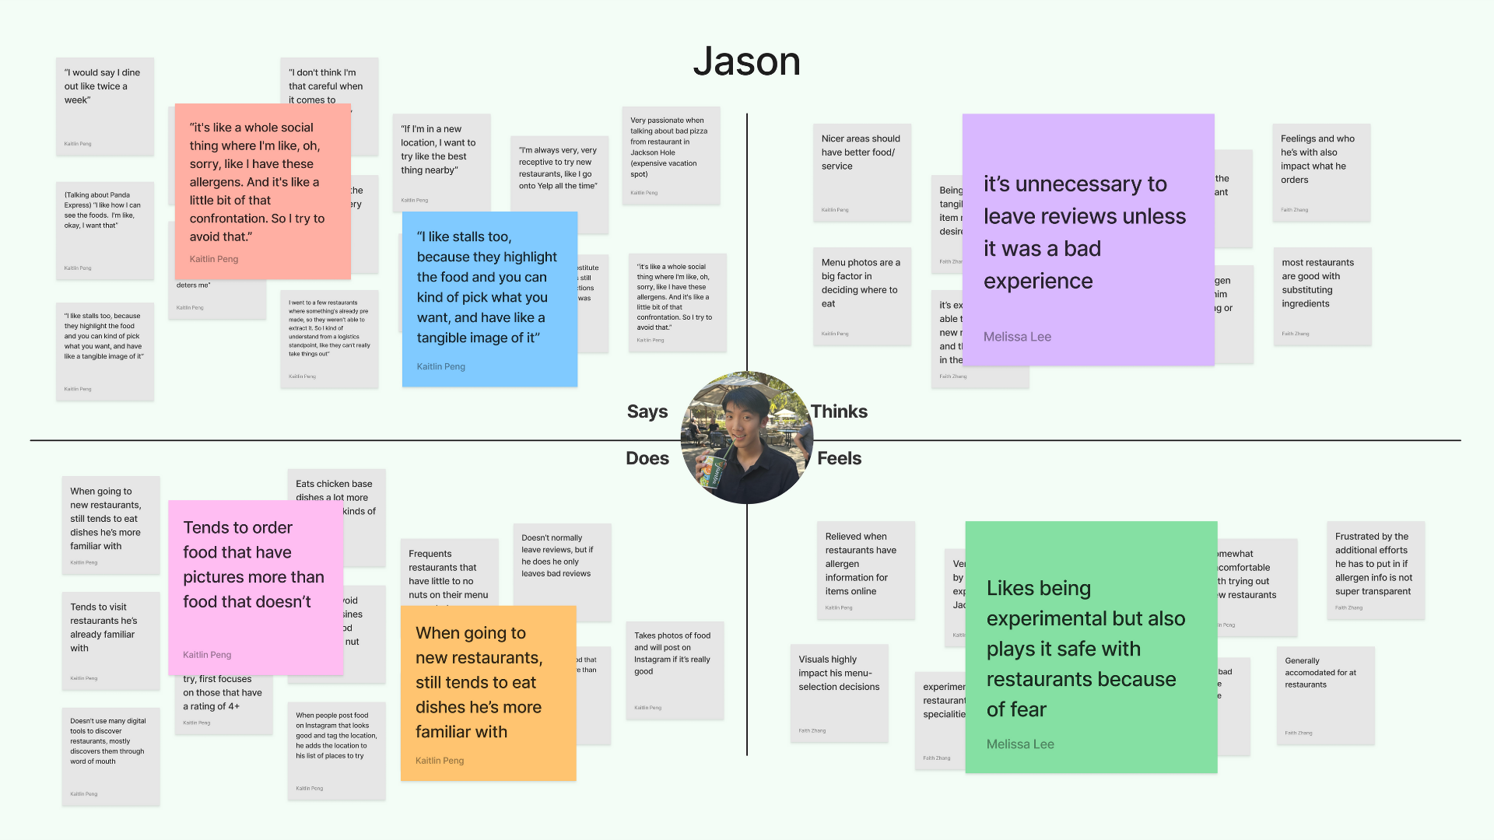
Notes:
- dislikes talking about all his allergens when going to restaurants because it's like a confrontation
- likes food stalls because they highlight the food you can see the food you're getting
- same note, tends to order food that have pictures more
- likes being experimental with new restaurants but still sticks to familiar dishes because of fear of allergic reactions

Slide 15
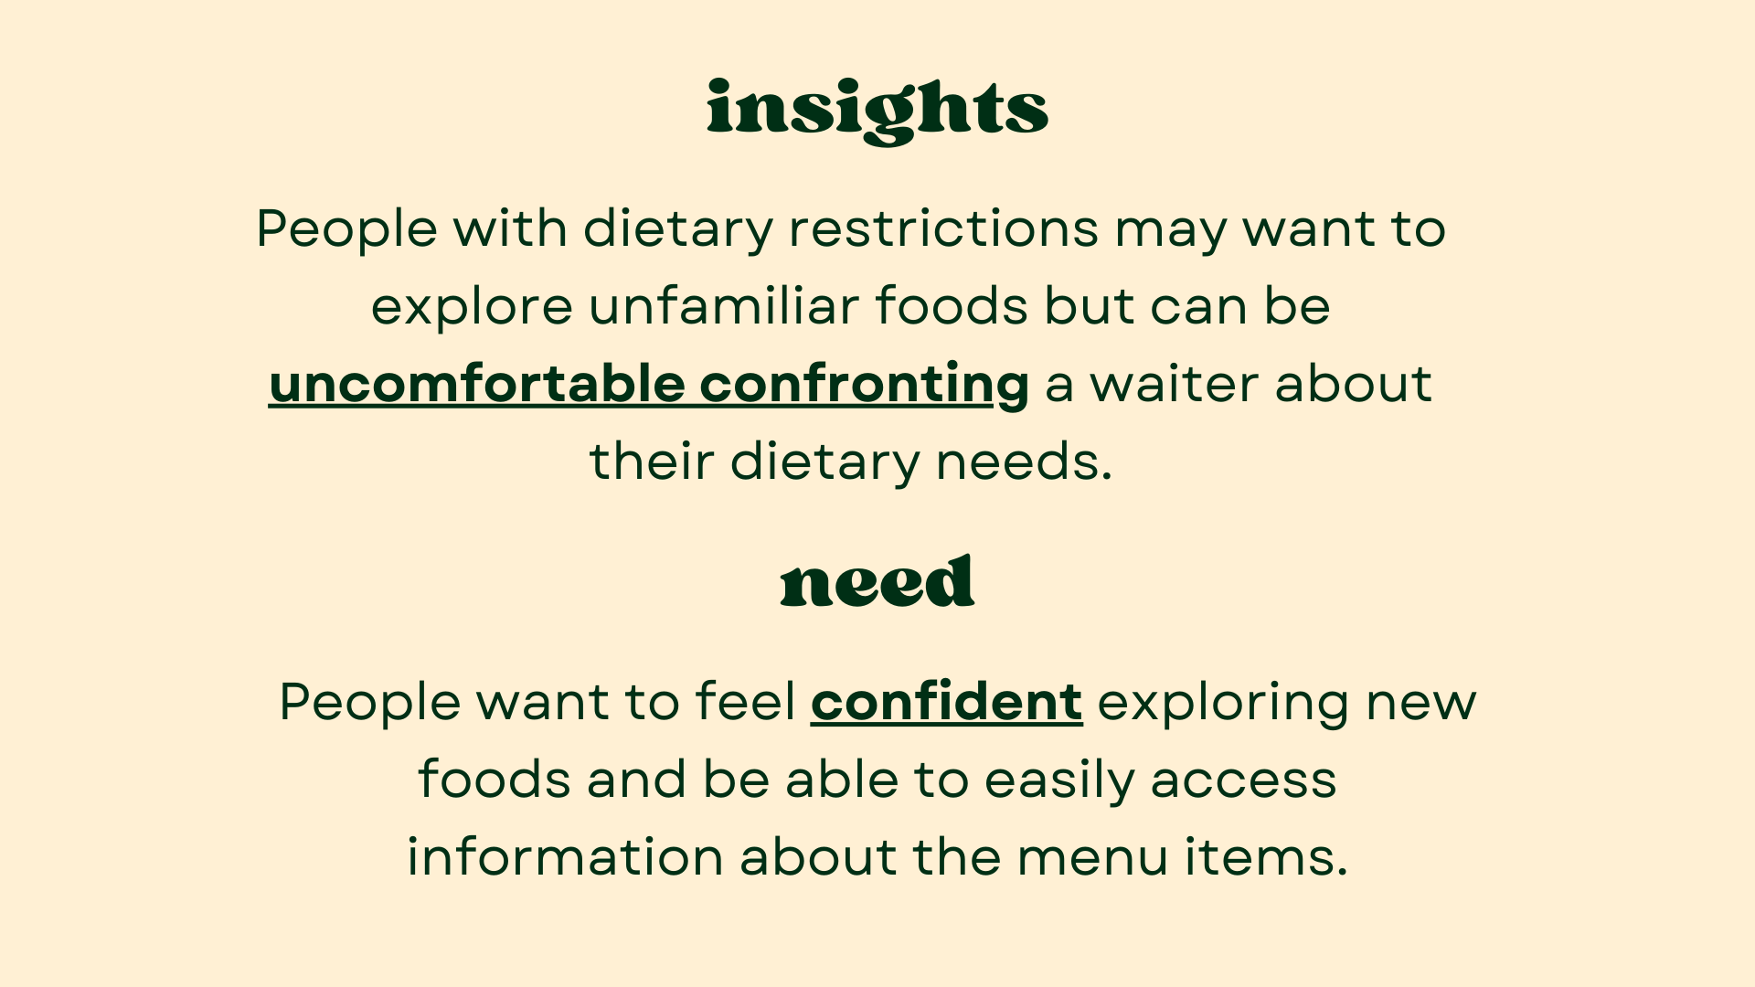
Notes:
- one of the insights from our findings was
- People with dietary restrictions may want to explore new foods but feel uncomfortable doing so, especially when needing to confront a waiter about their needs
- need identified was
- People want to feel confident exploring new foods and be able to easily access information about the menu items.

Slide 16
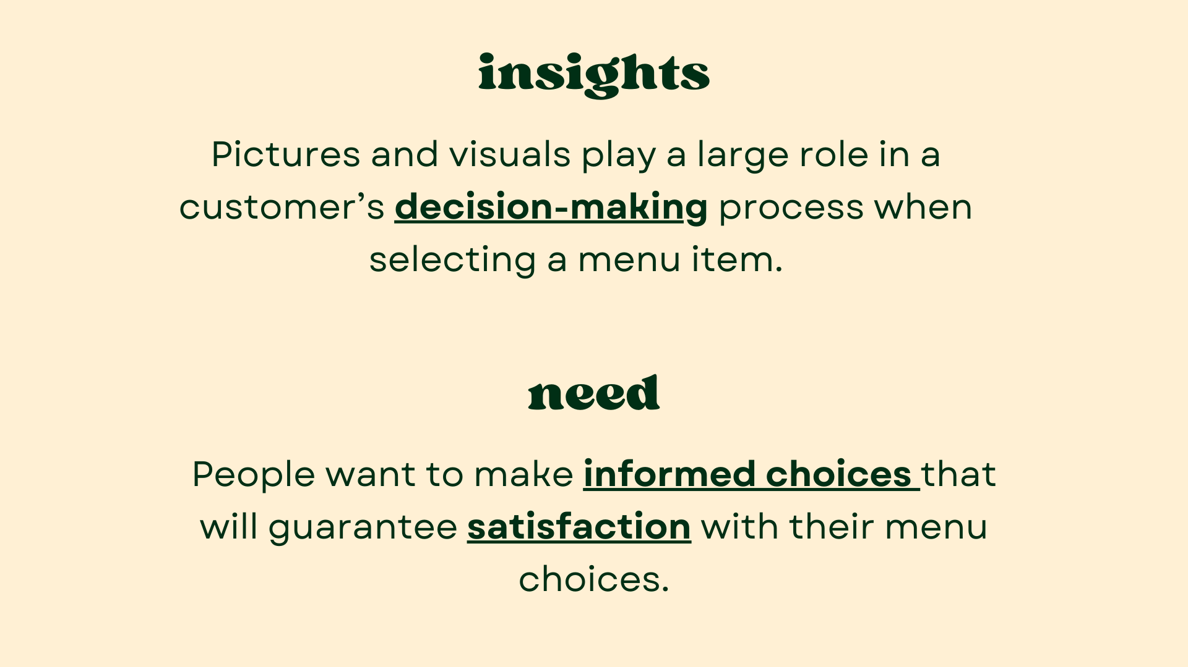
Notes:
- another insight was
- Pictures and visuals play a large role in a customer’s decision-making process when selecting what to eat
- need identified was
- People want to make informed choices that will guarantee satisfaction with their menu choices.

Slide 17
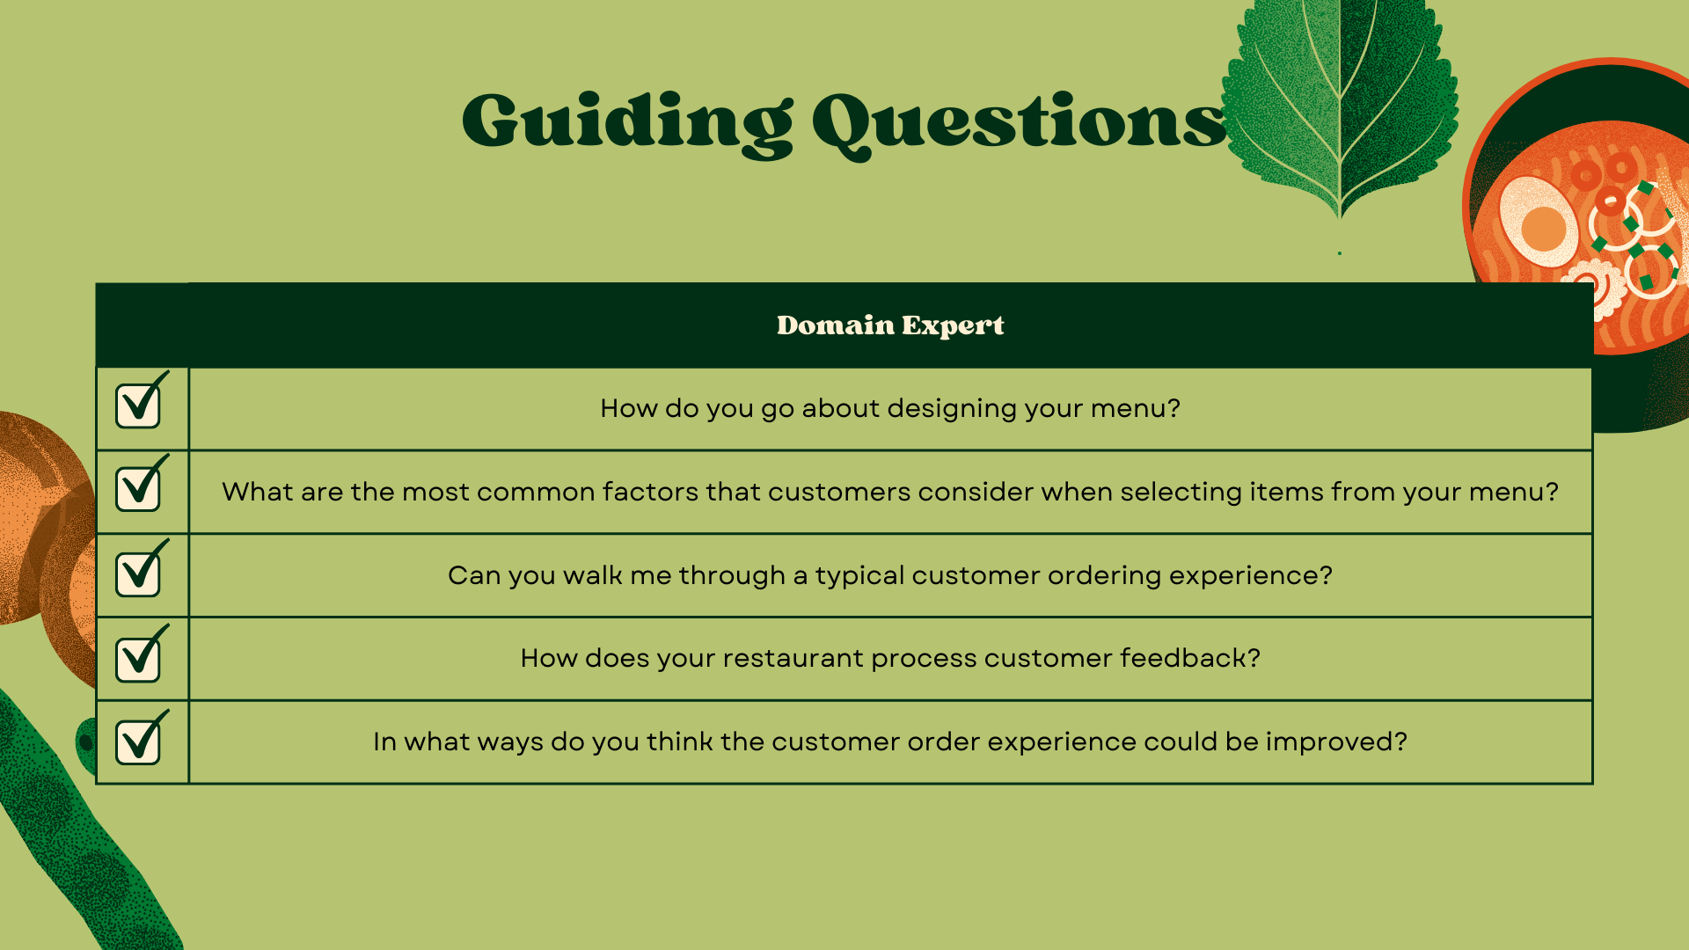
Notes:
- domain expert
- as mentioned, guiding questions were kind of different
- learn more about how the restaurant decides what goes on their menu and their point of view on how customers usually order food

Slide 18
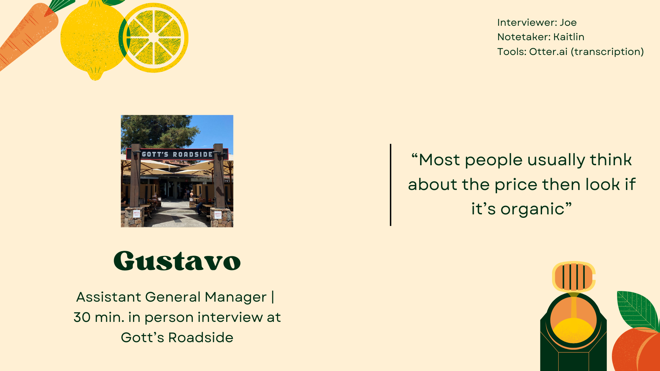
Notes:
- domain expert was gustavo
- assistant general manager at Gott's Roadside
- recruited by calling restaurants in the area and asking if a manager or restaurant owner is available for interview, and Gott's responded yes
- 30 min interview with him at outside seating at Gott's

Slide 19
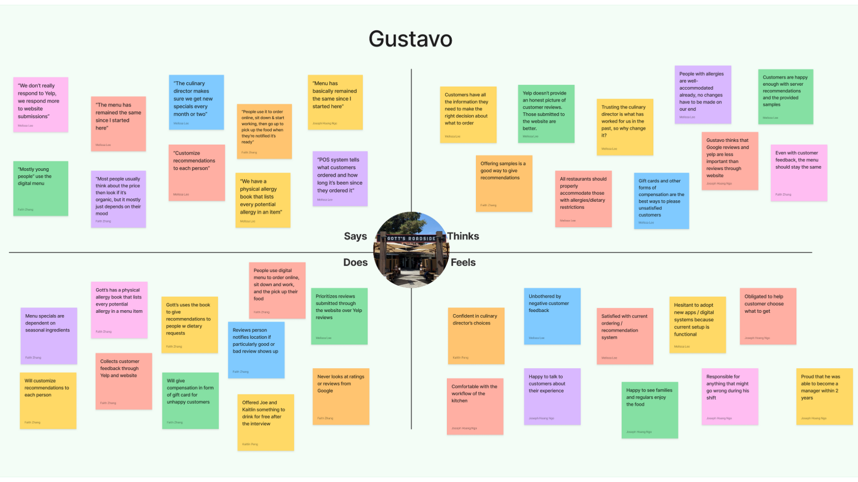

Slide 20
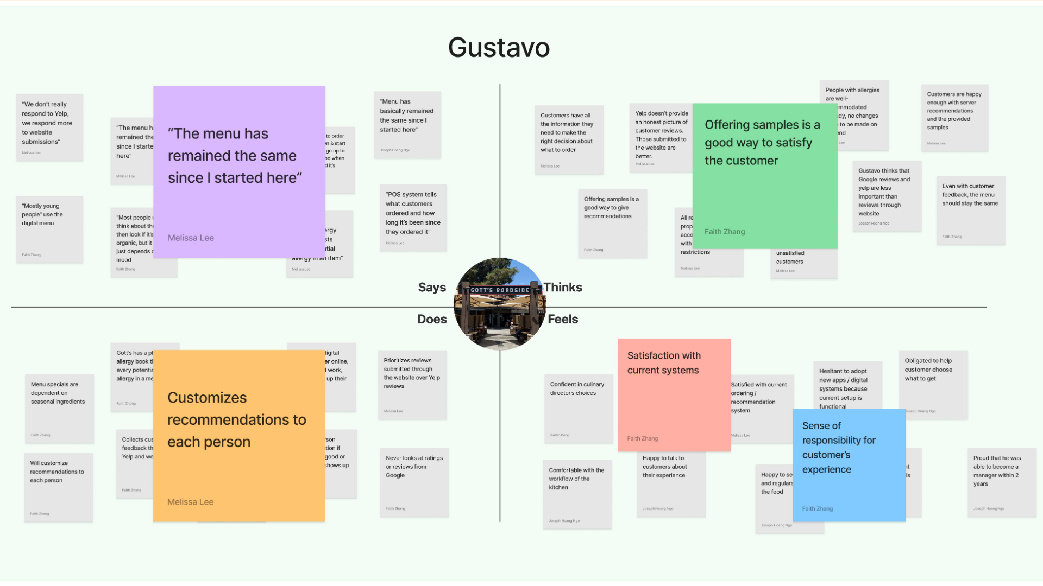
Notes:
- menu remained the same for 2 years
- when asked for recommendations from customers, they try to customize the recommendations by asking what they like and usually order
- also offer them samples of menu items which he thinks is a good way to keep customers happy
- feels a strong sense of responsibility for the customer experience

Slide 21
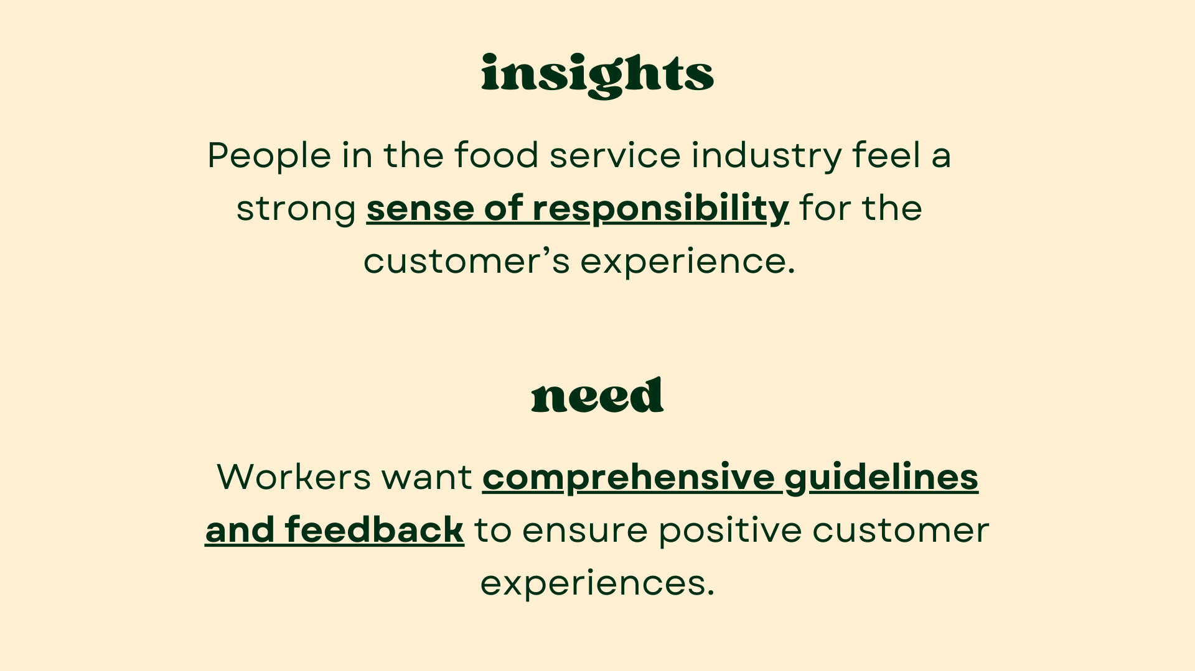
Notes:
- key insight from interview was
- People in the food service industry feel a strong sense of responsibility for the customer’s experience
- need identified was
- Employees want comprehensive guidelines and feedback to ensure positive customer experiences

Slide 22
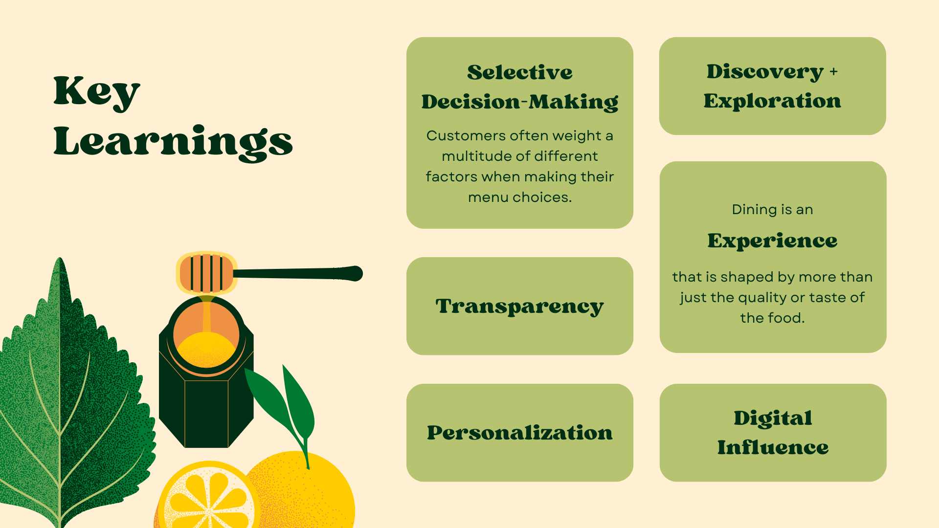
Notes:
- putting it altogether, key learnings were
- when it comes to deciding what dish to eat, customers weight a lot of different factors e.g. own preferences, pictures of the food, reviews, etc.
- dining is an experience that involves more than just the taste of the food
- people like transparency but also personalization when it comes to dish recommendations
- people normally value discovery and exploration when it comes to eating, though sometimes there are barriers to that
- digital tools like yelp, instagram, eater

Slide 23
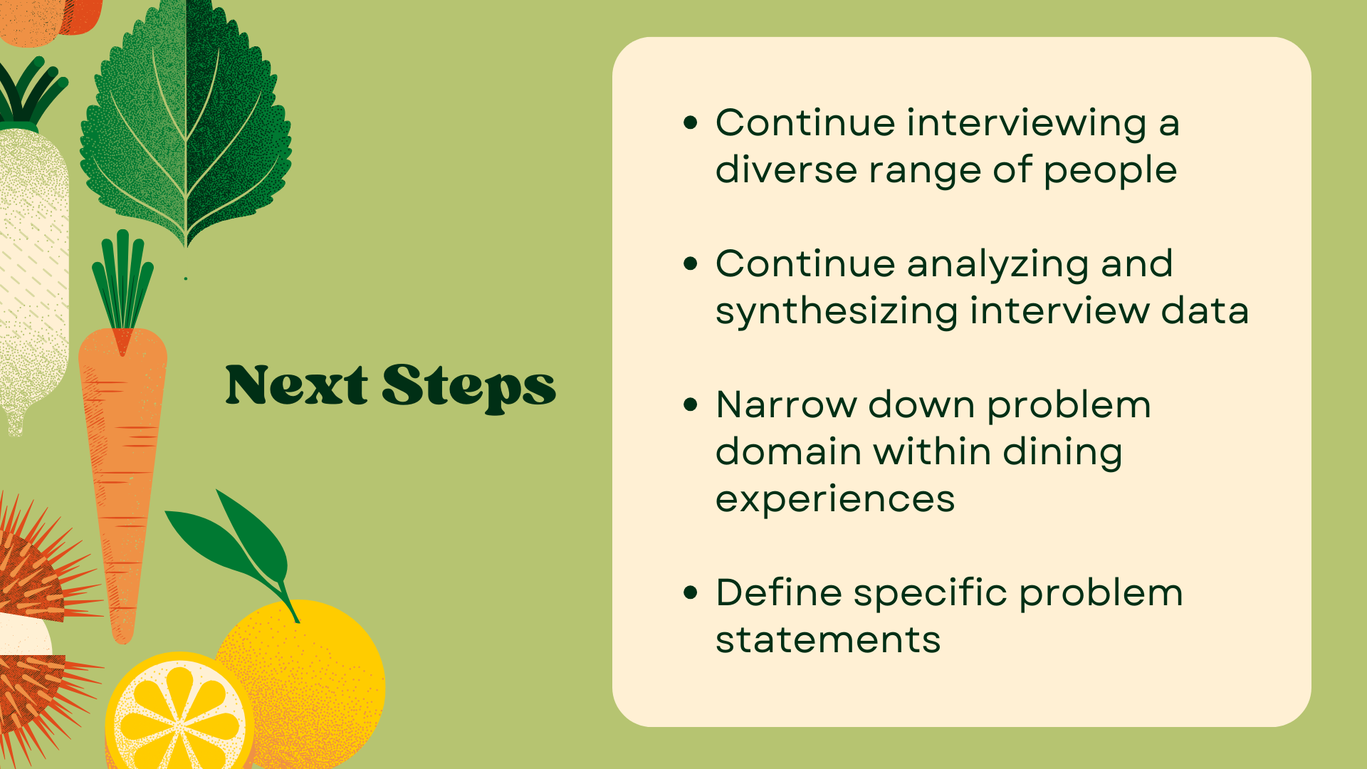
Notes:
- continue interviewing people
and synthesizing data
- narrow down problem domain within dining experiences
- define specific problem statements

Slide 24


Slide 25
